Slide 1


Where on earth can I charge my new ev?
Wesley Hall
Springboard
July 25, 2004

Slide 2

The dilemma
NOW
CO2 emissions are killing our planet.
1.2 million EVs sold in 2023 (U.S.)
EV sales up 52% YoY in 2023
SOON
33 million EVs by 2030
28 million EV charging ports required.

Slide 3
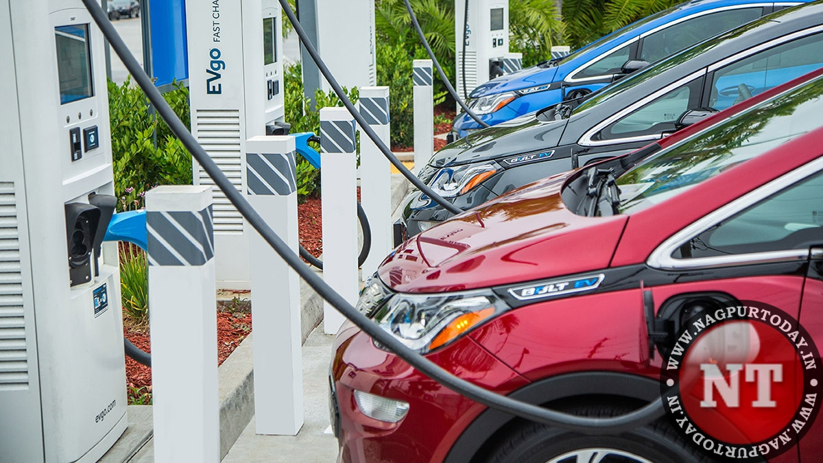
Analysis approach
Chargers per Capita
locations
Current vs. Future Needs
This Photo by Unknown Author is licensed under CC BY-SA-NC

Slide 4
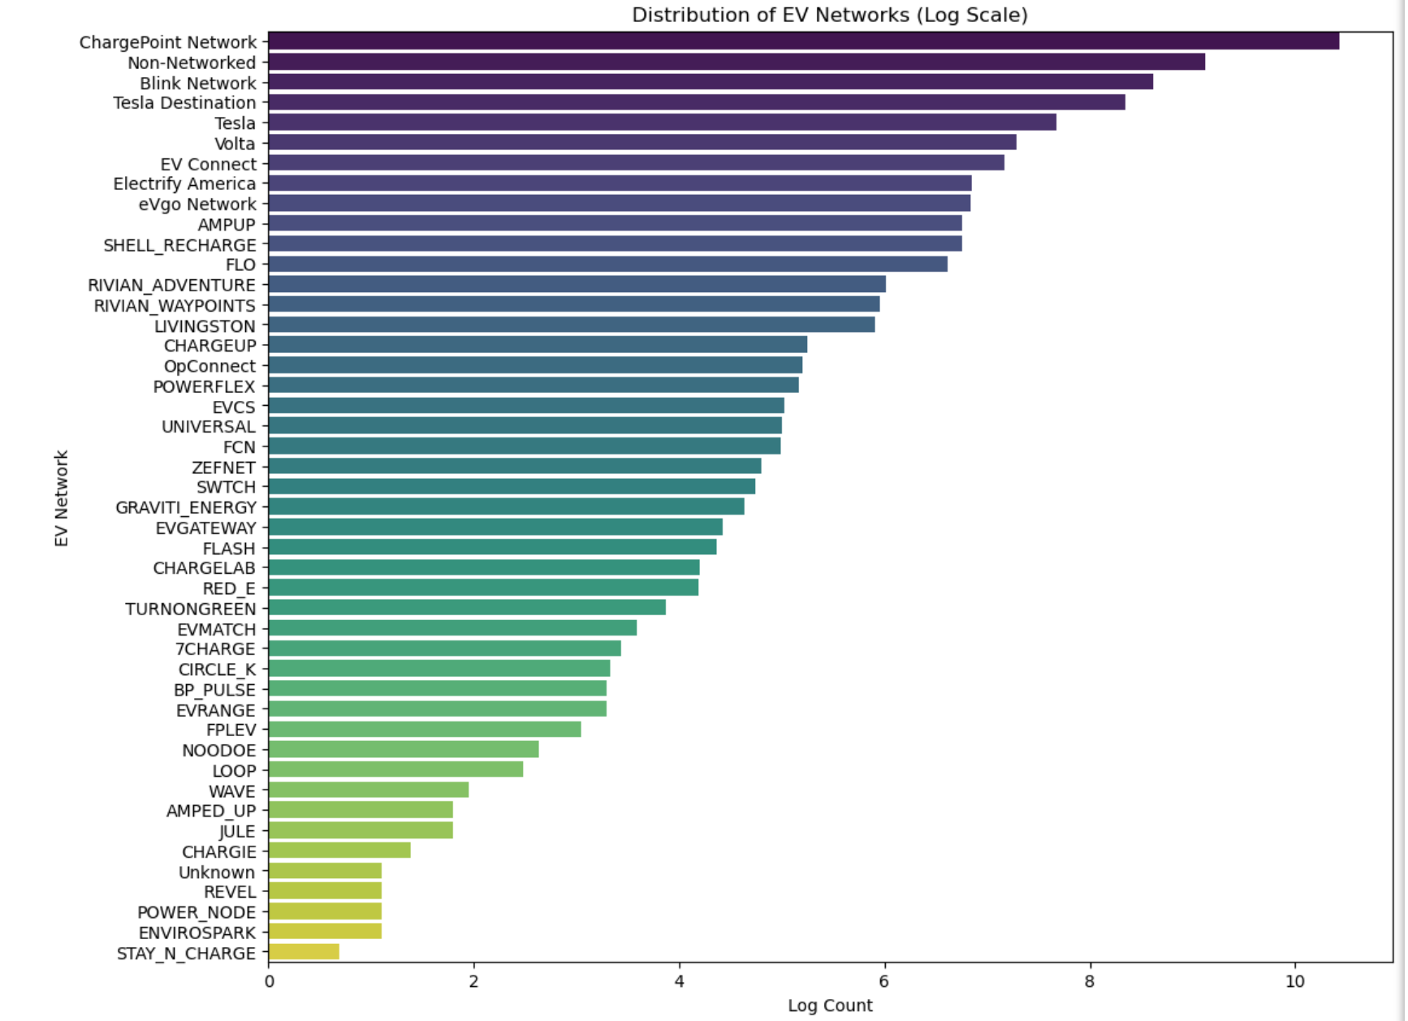
Current State of EV Charging Infrastructure
ChargePoint dominates
Tesla comes in close 2nd
This Photo by Unknown Author is licensed under CC BY-SA
This Photo by Unknown Author is licensed under CC BY-SA-NC

Slide 5
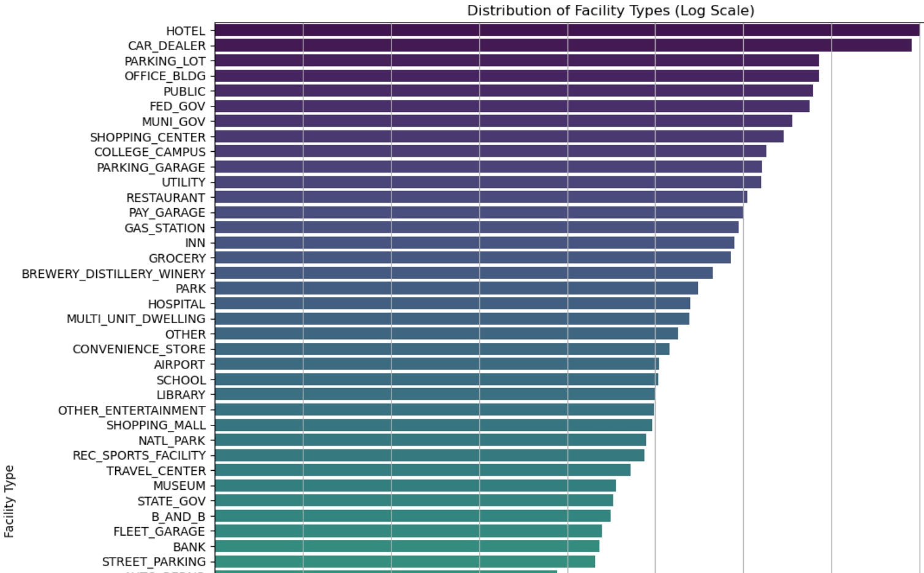
DISTRIBUTION OF FACILITY TYPES (TOP 25)

Slide 6
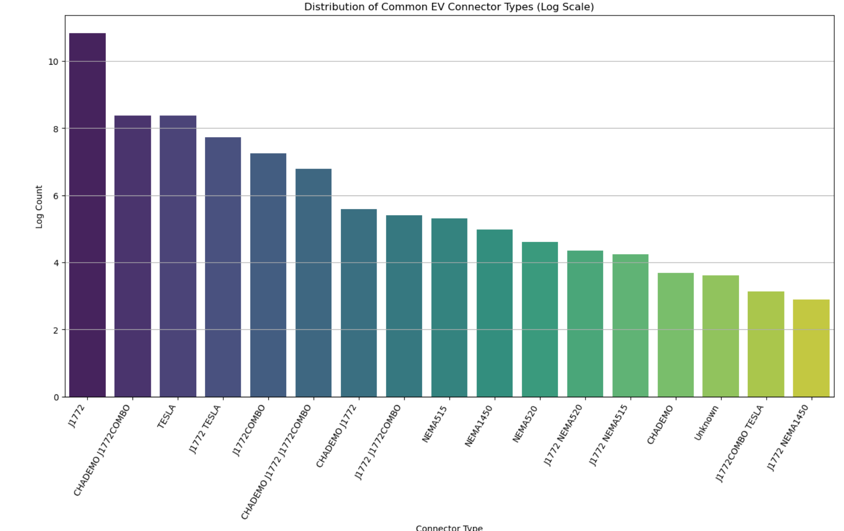
Distribution of connector types

Slide 7
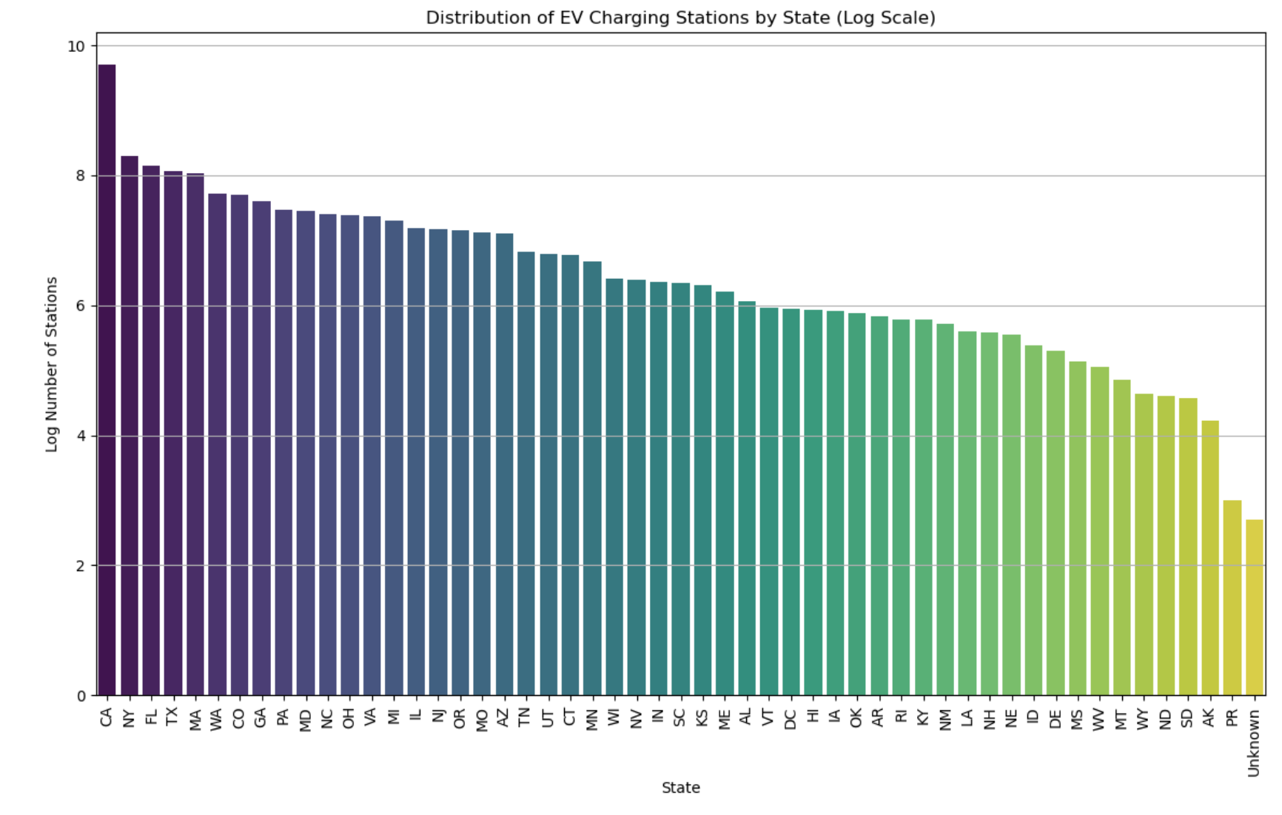
More charging stations in most populated states.

Slide 8
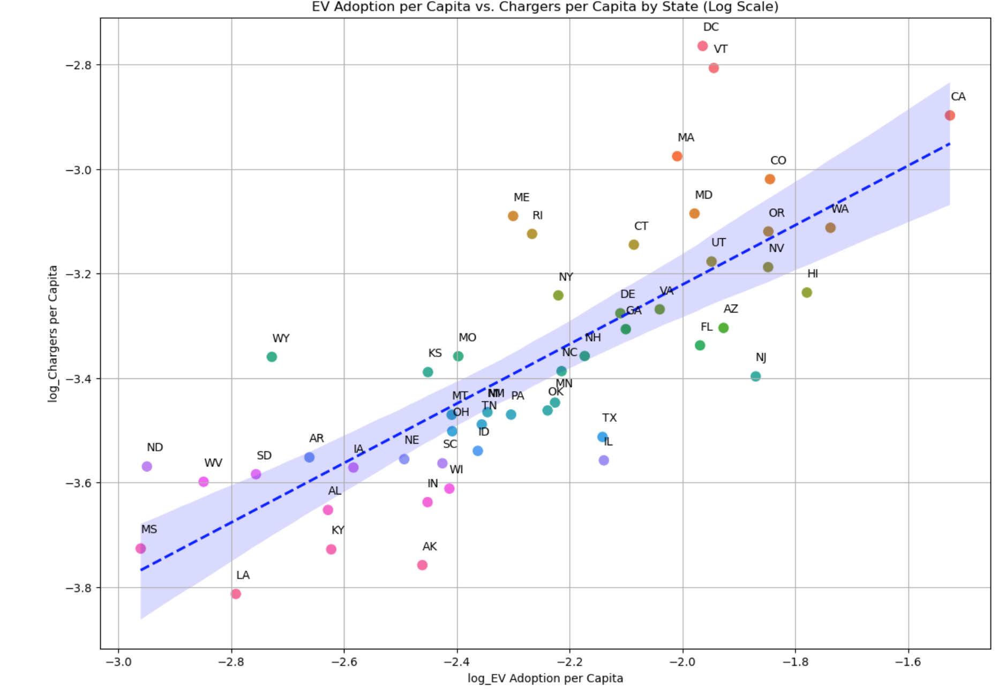
BUT… PER CAPITA by ev adoption TX , FL, AZ, NJ are lagging CA . DC, VT, MA, CO, WA, OR, & NV are best on track MS, LA, KY, Ak are far behind

Slide 9
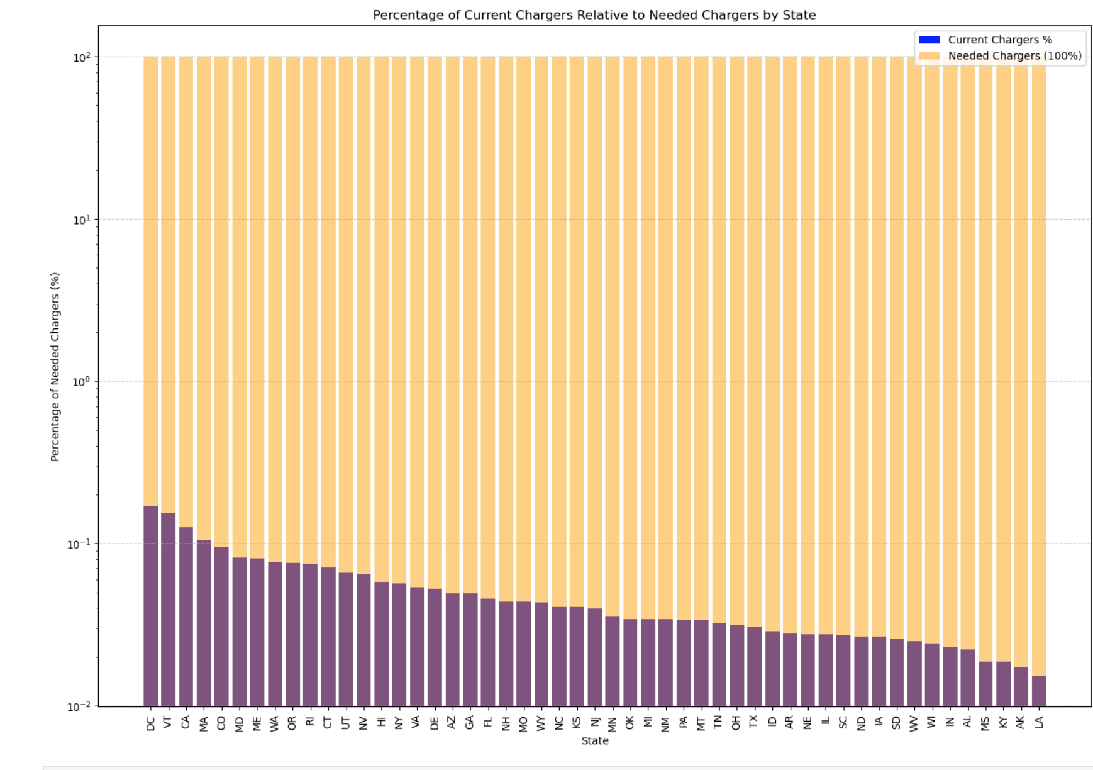
WHAT STATES ARE WORKING HARD TO SATISFY THE NEED?
TOP 10
DC, VT, CA, MA, CO , MD, ME, WA, OR, PI
BOTTOM 10
IA, SD, WV, WI, IN, AL, MS, KY, AK, LA

Slide 10
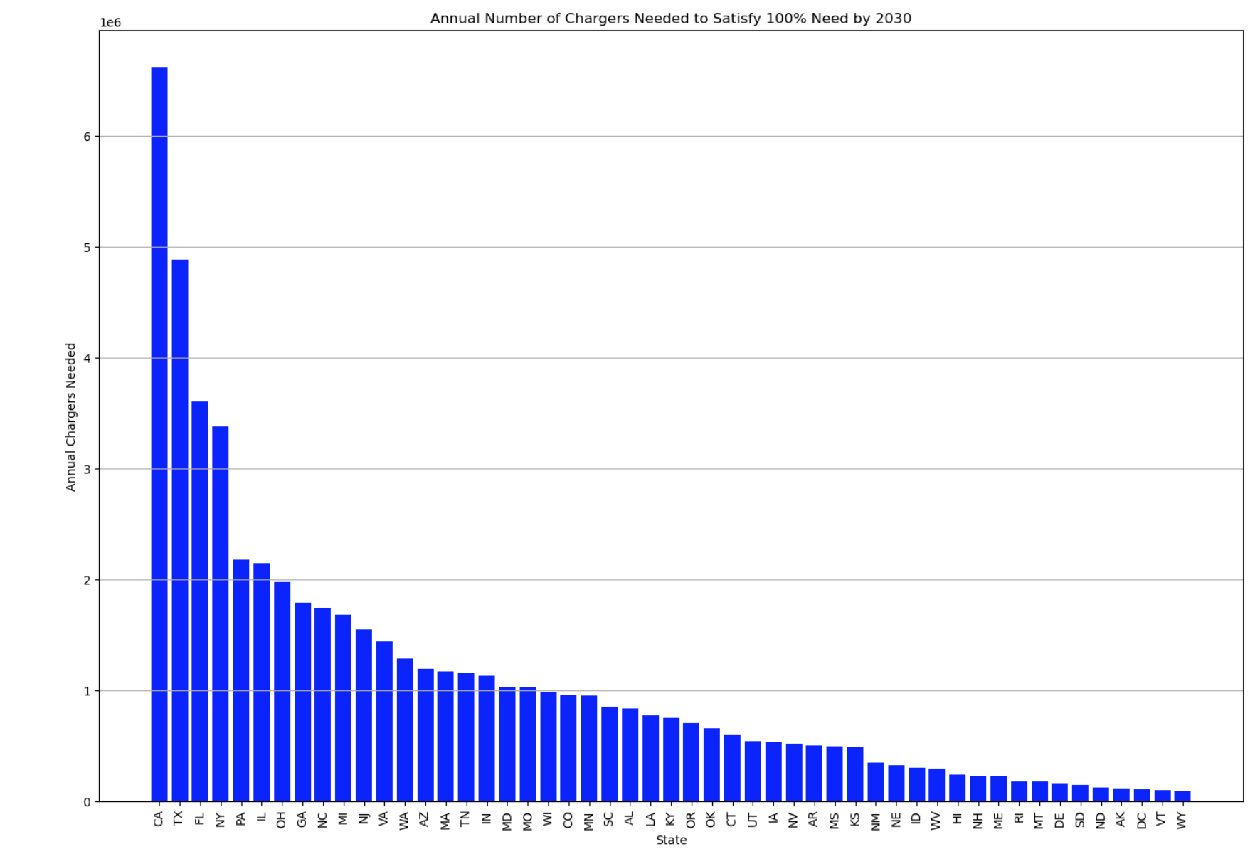
WHICH STATES NEED TO DO THE MOST WORK?
TOP 5 STATES
CA, TX FL,
NV, PA, IL
BOTTOM 5 STATES
SD ND, AK, DC, VT, WY

